Slide 1
Logistic Regression

Slide 2
What is Logistic Regression?
Supervised machine learning algorithm used for classification
Primarily used for binary classification problems
Outputs probability values between 0 and 1
Despite the name, it is a classification algorithm, not regression
Logistic regression is used to describe data and the relationship between one dependent variable and one or more independent
variables which can be nominal, ordinal, or of interval type

Slide 3
Applications of Logistic Regression
Spam email detection (Spam / Not Spam)
Medical diagnosis (Disease / No Disease)
Customer churn prediction (Churn / Not Churn)
Credit risk analysis (Default / No Default)

Slide 4
Linear Regression is Not Suitable
Linear regression outputs unbounded values
Predicted values cannot be interpreted as probabilities
Sensitive to outliers in classification problems
Logistic regression solves these issues using sigmoid function

Slide 5
Binary Logistic Regression
Used when target variable has two classes
Uses sigmoid activation function
Most common form of logistic regression
Example: Yes / No classification

Slide 6
Multinomial Logistic Regression
Used when target variable has more than two classes
Uses Softmax function
Predicts probability for each class
Example: Low / Medium / High risk

Slide 7
Regularization in Logistic Regression
Used to prevent overfitting
L1 Regularization (Lasso) – feature selection
L2 Regularization (Ridge) – coefficient shrinkage
Elastic Net – combination of L1 and L2

Slide 8
Binary Logistic Sigmoid (Logistic) Function
Transforms linear output into probability
Formula: σ(z) = 1 / (1 + e^(-z))
Output range: 0 to 1
Used to make classification decisions

Slide 9
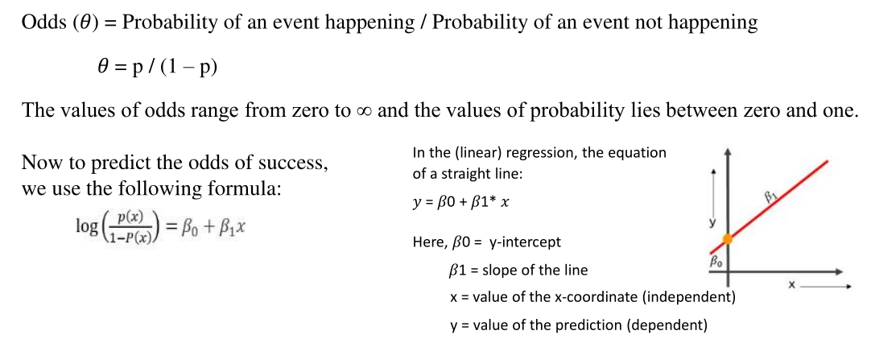

Slide 10
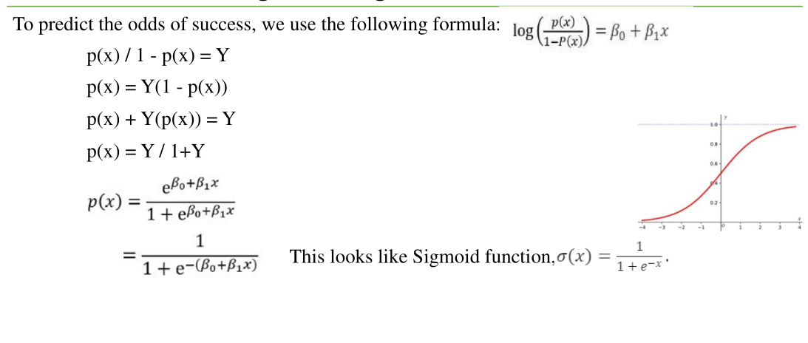

Slide 11
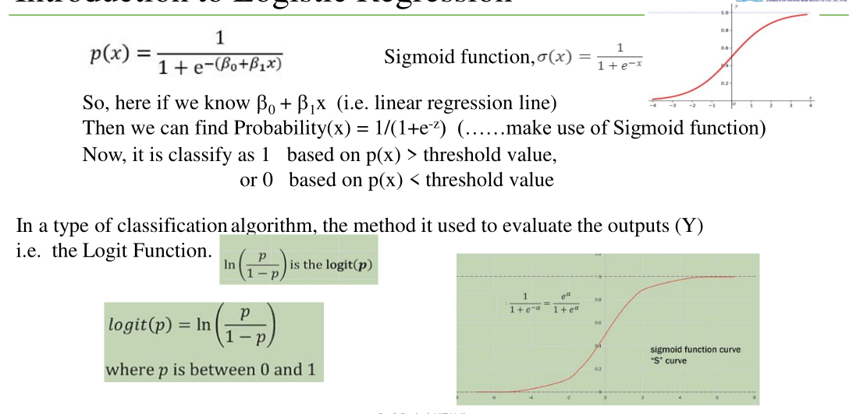

Slide 12
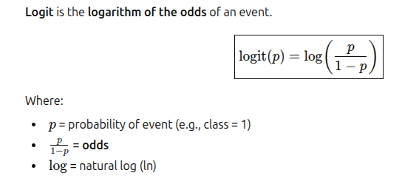
Logit is the log of odds in logistic regression.
It is the core transformation that makes logistic regression linear.

Slide 13
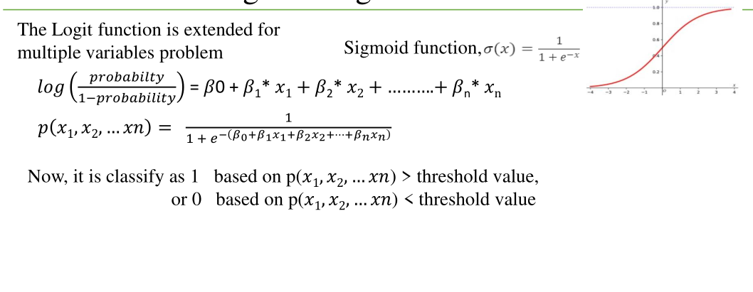

Slide 14
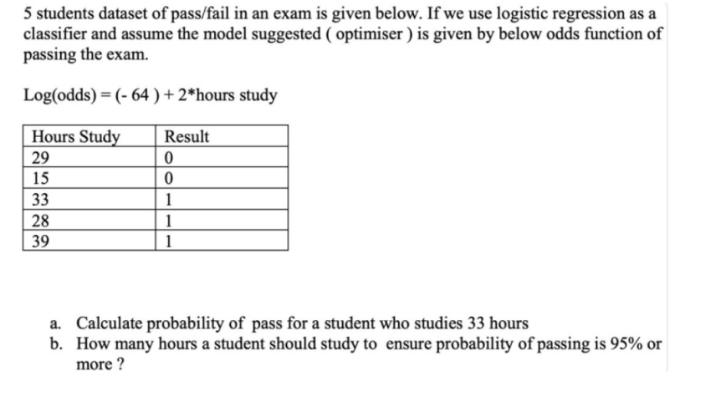

Slide 15
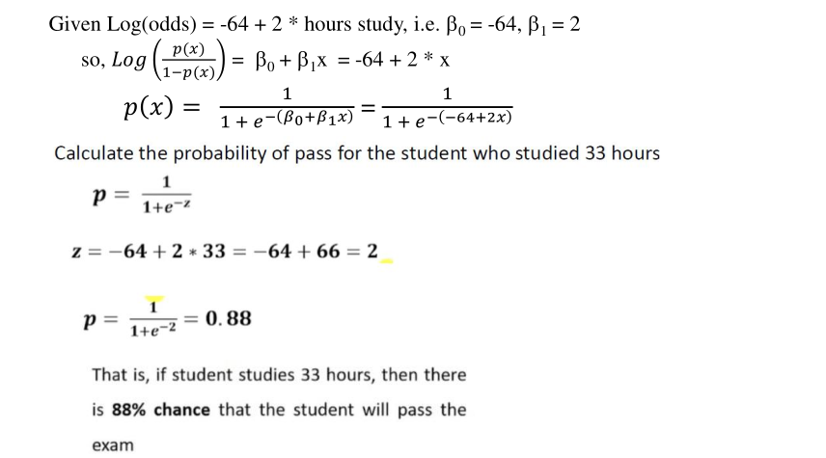

Slide 16
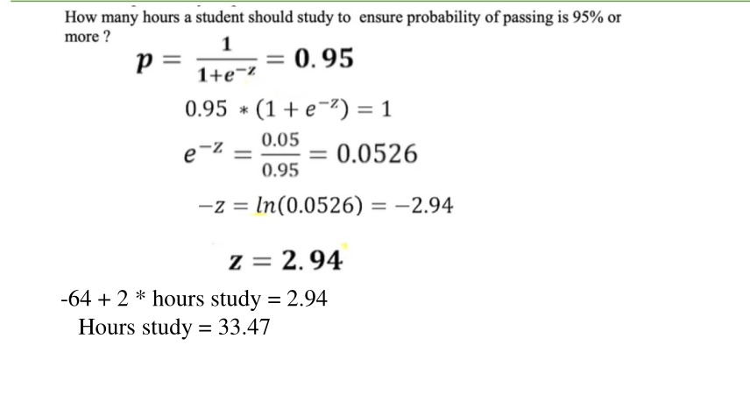

Slide 17
Decision Boundary
A threshold is applied to predicted probability
Common threshold value is 0.5
If probability ≥ 0.5 → Class 1
Decision boundary is linear

Slide 18
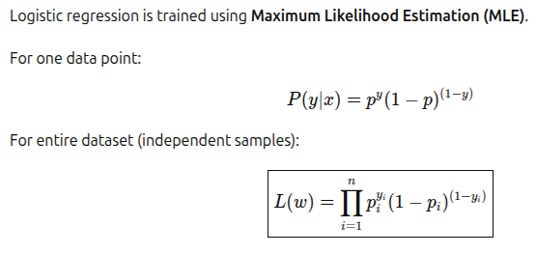
Logistic regression is trained by maximizing likelihood (or equivalently minimizing negative log-likelihood, also called log loss / cross-entropy loss).

Slide 19

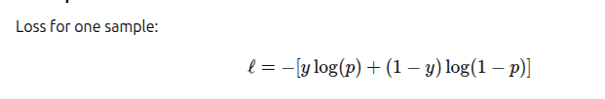
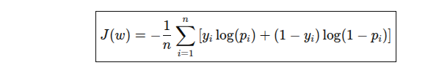
Log Likelihood
Loss = -log L(w)
Loss function, To minimize loss

Slide 20
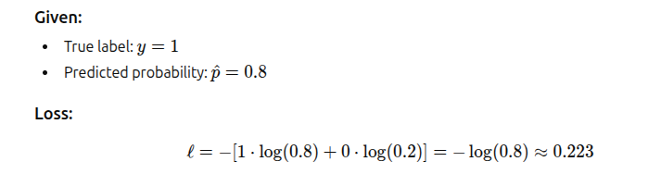
Example- single data

Slide 21
Advantages of Logistic Regression
Simple and easy to interpret
Computationally efficient
Provides probability outputs
Works well for linearly separable data

Slide 22
Limitations of Logistic Regression
Cannot capture complex non-linear relationships
Sensitive to multicollinearity
Requires feature engineering
Performance drops on highly imbalanced data

